Slide 1
Business Letters
Unit 6:Recruitment Correspondence

Slide 2
Learning Objectives
After studying this unit you should be able to:
State all the documents involved in the process of recruiting staff
Compose realistic business documents that may be used in the recruitment process:
Application letter
CV
Invitation to interview
References
Testimonials
Offer of employment
Job description
Letter of acceptance
Letter of resignation

Slide 3
THE RECRUITMENT PROCESS
Various letters and documents are involved in the process of applying for a job.
Applicant
Employer
Letter to referee
Letter of resignation
Curriculum vitae
Offer of employment
Invitation to interview
Reference
Job description
Letter of rejection
Testimonial
Letter of acceptance
Letter of application
Contract of employment

Slide 4
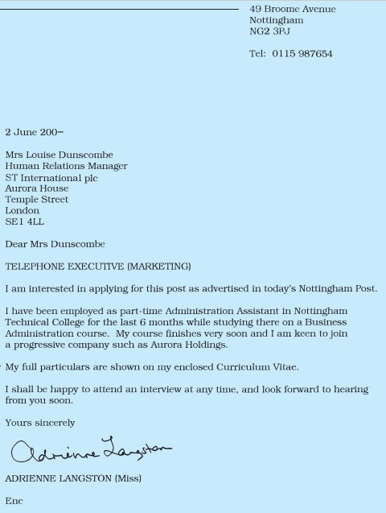
APPLICATION LETTER
Keep your application letter short & concise.
Don’t forget your personal address.
Address to person named.
Use the job title as subject.
Give brief details.
Enclose your CV.

Slide 5
CURRICULUM VITAE
Personal details
Education
Qualifications
Working experience
Additional Information
Reference
Curriculum vitae is Latin, meaning ‘the course of one’s life’.
Organise all the information logically (chronological order) under headings and use columns where appropriate.
Use professional Reference, e.g. teacher, boss, etc.

Slide 6
Class Activity
1. PERSONAL ASSISTANT to the President of JUST
Applicants should be suitably qualified, experienced and computer literate.
2. IT ASSISTANT at JUST
Applicants must have relevant experience to join the IT team which provides IT support to 100 technical and administrative staff and 5 Computer Labs.
Application letters with full CV should be sent to:
Mahdi Mohamed Omar
Lecturer in Communication Skills, JUST
Digfeer Campus
Benadir-Digfer Road
Mogadishu - Somalia

Slide 7
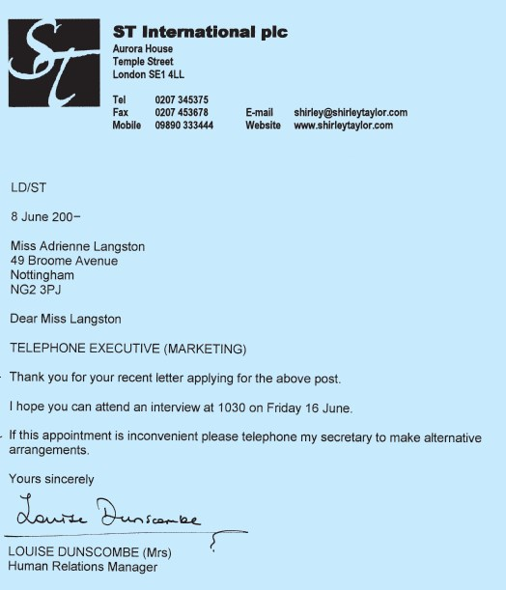
INVITATION TO INTERVIEW
A letter inviting shortlisted applicants to attend an interview should be short.
Thank the person for his/her application.
Give a day/date/time for the interview.
Suggest how alternative arrangements can be made.

Slide 8
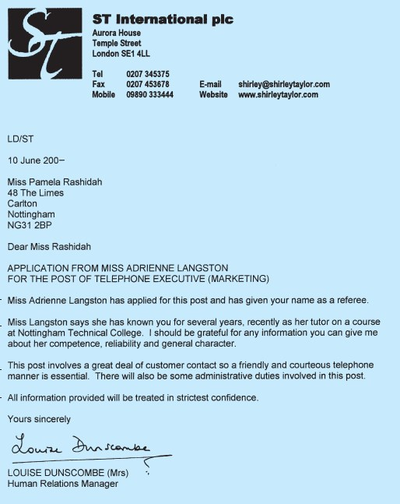
REFERENCES
Companies telephone or write to referees asking: the character, personal qualities & work performance of the person they want to offer the job.
In this letter, state the information you require.
Ensure confidentiality.

Slide 9
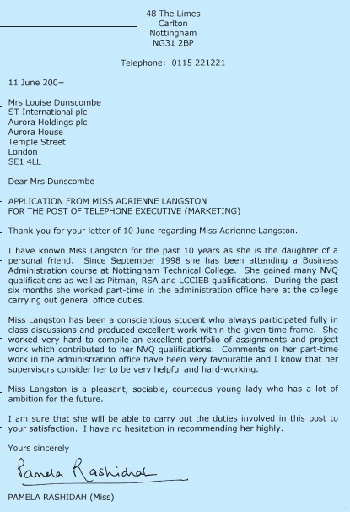
REFERENCES
Inform your referees whenever you apply a post.
It’s better to give your referee your updated CV.

Slide 10
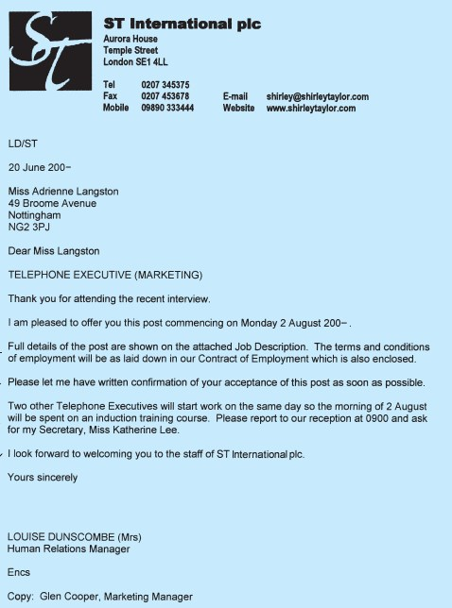
OFFER OF EMPLOYMENT
After final decision, a formal offer of employment will be sent to the successful applicant.
Offer the job & state starting date.
Enclose job description & contract.
Request written confirmation.
Give relevant details & instructions.
Finish with welcoming close.

Slide 11
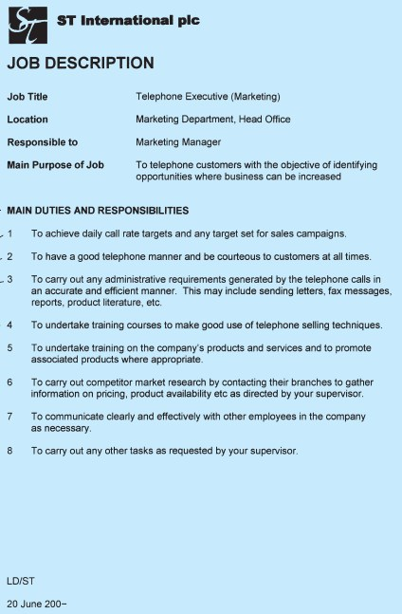
JOB DESCRIPTION
States the title of the post and to whom the person reports.
Gives full details of the duties and responsibilities involved.
Express all points consistently (To ...)
Finish with the standard clause.
Don’t forget a reference & date

Slide 12
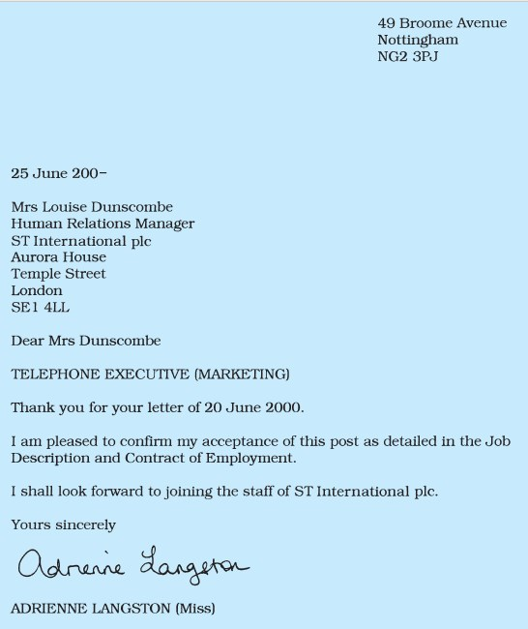
LETTER OF ACCEPTANCE
Write a formal letter to the company accepting the post.
Keep it simple.
Be consistent – display all your letters in the same style.
Finish appropriately.

Slide 13
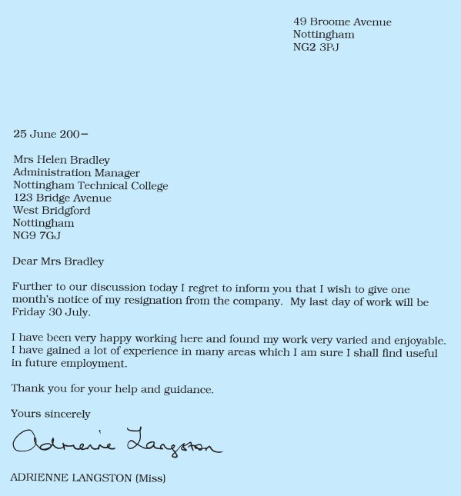
RESIGNATION LETTER
When you have been in employment and wish to leave for whatever reason, write a formal letter resigning from your present post.
Express regret and state last day of work.
Explain tactfully & courteously.
Give thanks

Slide 14
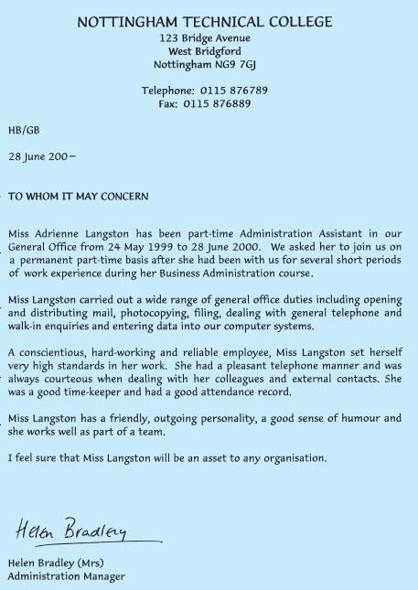
RECOMMENDATION LETTER (Testimonial)
Use “To whom it may concern” in place of receiver’s address.
State position and duration of employment.
Mention the duties performed.
State the employee’s working attitude & how work was carried out.
Mention personal qualities.
Give a recommendation
No salutation & complimentary close are necessary.

Slide 15
Thanks,
GOOD
listeners
The END

